Slide 1


Leadership for School Change in Post-Pandemic Times
Professor Michael Fullan
OISE/UT
Education Leadership Forum cum Oxford University Press
Hong Kong’s 60th Anniversary
November 6, 2021

Slide 2
Three Phases of Educational Change
Phase One:
Establishing a
Basic Foundation
(2003-2012)
Phase Two:
Embedding Capacity Building, Collaboration, Leadership
(2010-2018+)
Phase Three:
Overload, Ambiguity, Innovation
(2020-present)

Slide 3

Leading Learning Beyond Tomorrow
Three Preliminary Points:
1.
Progress over the first two decades on the ‘tomorrow’ agenda, but it has been slow and not deep.
2.
It is not clear how we could ‘leapfrog into the future’ in the short order.
3.
Solution unknown: Deep, multi-faceted, beyond complexity

Slide 4
Ontario Example
Phase One:
Estalishing a Basic Fundation
(2003-2012)
Literacy
Numeracy
Secondary School
Close the Gap

Slide 5

Snapshot – Province of Ontario
Over 1 million square kilometres of land
40% of Canada’s 33.6 million people
In 2013, Ontario received 40.0% (103,402) of permanent resident admissions to Canada (258,619)
2 million students; English is not the first language of many of our students
About 5,000 schools in 72 school districts
Total board staff: 213,700
126,000 teachers (unionized teaching and support staff)
7,600 principals and vice-principals
Funding of $22.53B (CDN) in 2014-15
About 20% of provincial budget

Slide 6
Levers to Successful Improvement Systems
A small number of ambitious goals
Leadership at all levels
High standards and expectations
Investment in leadership and capacity building related to instruction
Mobilizing data and effective practices as a strategy for improvement
Intervention in a non-punitive manner
Reducing distractions
Being transparent, relentless and increasingly challenging
Notes:
Here are the key levers we use to leverage success across our system. I’ll elaborate a bit on each of these….

Slide 7
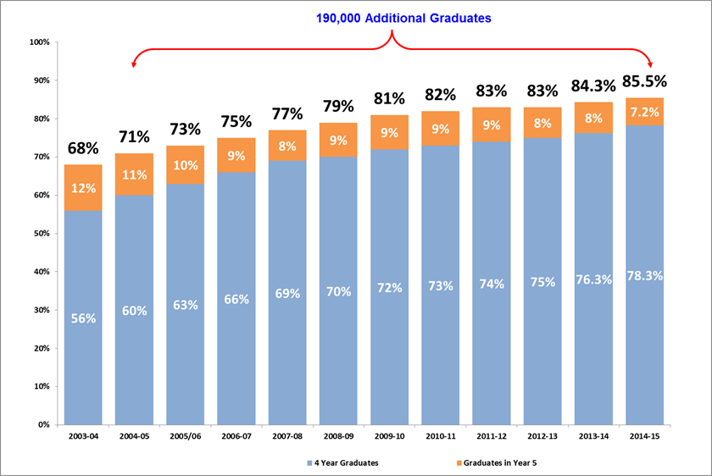
High standards and expectations:
Provincial Graduation Rate
6 key levers for secondary reform:
Leadership infrastructure
Engaging and relevant programming
Effective instruction
Focused Interventions for students at risk of not graduating
Legislation and policy development
Research, monitoring and evaluation
Notes:
The rate is now at 84%. In 2013-14 there were approximately 132,000 graduates from the cohort of students who started grade 9 in 2009-2010. This number also includes those students who graduated within four years.
Our target is 85% of Ontario students will graduate in 5 years which is up from the 68% graduation rate in 2003-04 when the government took office.
In 2013-14 alone, 25,000 additional students graduated than would have had the rate remained at the 2003-04 rate of 68%. This is a total of approximately 163,000 more students who have graduated since 2003-04 than would have if the Student Success Strategy were not in place.
For the first time this year, the province published each board’s grad rate. This will continue to draw attention to our efforts to help more student be successful.
This significant success allows us to think now more deeply about what successfully completing secondary school should give our students…
An Ontario Secondary School Diploma,
An entry qualification for post-secondary learning, the workplace, or apprenticeship
Preparation for a successful life
A means by which to clarify their interests, goals, assets / strengths, and ability to learn
A means to develop good character and judgement
and innovating, creative and “entrepreneurial” orientation (in full, not just business) (ie. a predisposition to action)
And let’s not forget that there are students for whom preparation for independent living is a pursuit of equal value in our system.

Slide 8
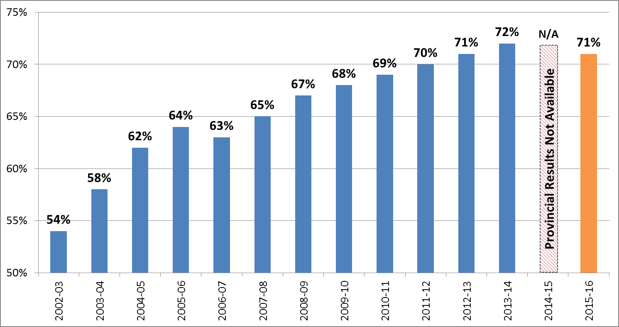
Elementary Outcomes: Achievement Results
4 key levers for elementary reform:
Improving classroom teaching and learning
Improving school effectiveness
Leadership capacity building
Research and evaluation
Notes:
The overall combined Grade 3 and 6 EQAO results for 2015-16, both English and French boards, is 71%. This is a decrease of one percentage point compared to 2013-14, and an increase of 17 percentage points compared to 2002-03.
With the EQAO assessments of Grades 3 and 6 reading, writing and mathematics not being administered in English-language public elementary schools due to labour disruptions, approximately 67% of Ontario elementary students did not write the assessments in June 2015 (calculation based on 2013-14 EQAO participation data). As a result, of the lack of an EQAO provincial result, the Ministry was not able to announce an overall provincial percentage of elementary student achievement for the 2014-15 school year.
EQAO assessment results show there is still more work to be done to help students who are working toward meeting the provincial standard. One area, mathematics, is persistently trending downwards .
Progress over the past ten years is a result of focused work centred around 4 key levers for elementary improvement:
Improving classroom teaching and learning
Improving school effectiveness
Leadership capacity building
Research and Evaluation
8

Slide 9

Capacity Building, Collaboration, Leadership
Phase Two:
Embedding Capacity Building, Collaboration, Leadership
(2010—2018+)
Building System Culture for Continuous Improvement

Slide 10
Leading in Crisis : Reimagining the Future
Professor Michael Fullan
OISE/UT

Slide 11

Coherence…
The shared depth of understanding about the nature of the work.

Slide 12
Clarity of Strategy
Successful change processes are a function of shaping and reshaping good ideas as they build capacity and ownership.

Slide 13
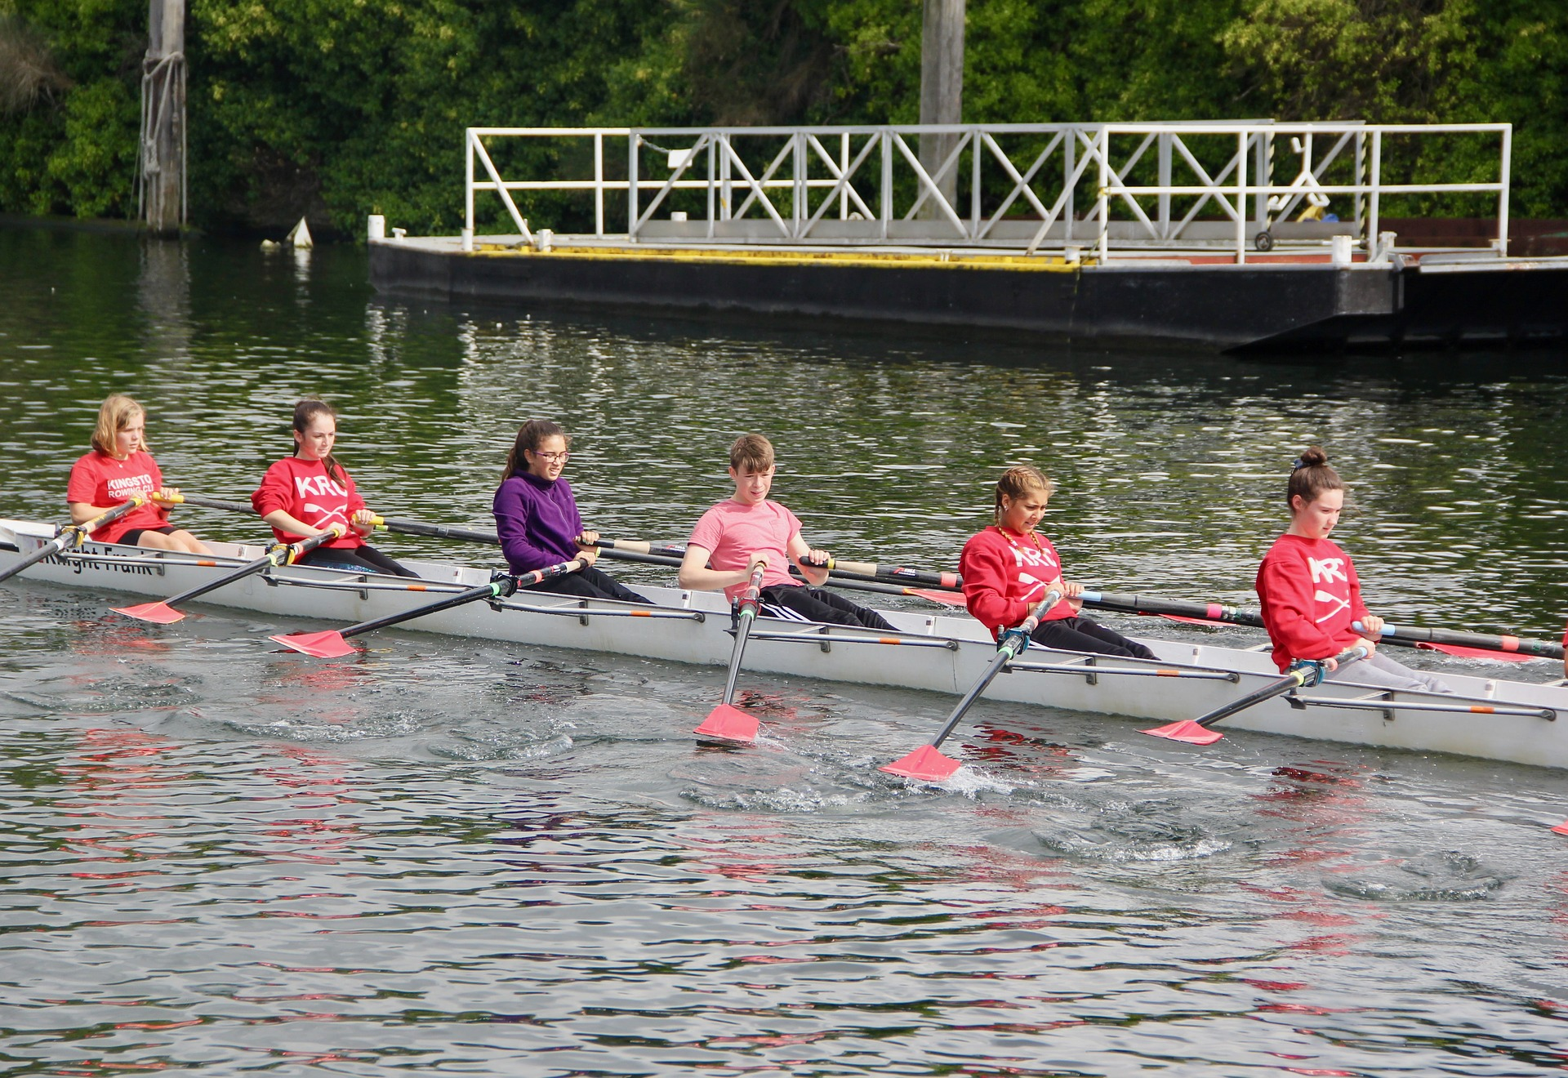
Collaboration
Collaborative cultures develop unity of purpose and specific solutions

Slide 14
Factors Influencing Student Achievement
  Collective teacher efficacy effect size:
  1.57
  (all other effect sizes: .065-0.29)

Slide 15

Collective Efficacy
Shared belief in conjoint capacity to produce results
Primary input is ‘evidence of impact’
Culture of collaboration to implement high-yield strategies
Leader participates in frequent, specific collaboration
—Hattie, 2017

Slide 16

Professional Collaboration with Purpose
Teachers didn’t distinguish between formal and informal collaboration
Candid, deliberative, supportive norms
Critical stance on curriculum and pedagogy
Strive for continuous innovation and improvement
Collaboration sustained and protected from competing external demands
Collective sense-making and integration of curriculum policy and existing practice
—Datnow & Park, 2019

Slide 17
Supporting Teachers Emotionally
Buffering teachers from external demands
Being a source of inspiration for improving practice
Lightening the burden around curriculum design and instructional planning
Being a site for celebrating student learning
—Datnow & Park, 2019

Slide 18
Collaborative Professionalism is NOT Professional Collaboration
The joint work of collaborative professionalism is embedded in the culture and life of the school.
Where educators care for each other as fellow professionals as they pursue their challenging work.
Where they collaborate in ways that are responsive to and inclusive of the culture of their students, themselves, the community and society.
—Hargreaves & O’Connor, 2018

Slide 19
Networks: Go Outside to Get Better Inside
Builds External Networks/Partnerships Hallmarks
Sees their role as a leader outside the work environment
Understands their role as part of a network
Strong ability to engage people
Uses technology to expand and manage
—Hargreaves & O’Connor, 2018

Slide 20

Connected Autonomy
Be your own person
Contribute to the learning of others
Learn from others

Slide 21

Key Principle
Connected Autonomy: A better Concept than Collaboration
A single concept that encompasses the state of being relatively
autonomous, and related to others.
Independence and responsibility to others are simultaneously embraced.
The progress of individuals and the group are equally valued.

Slide 22
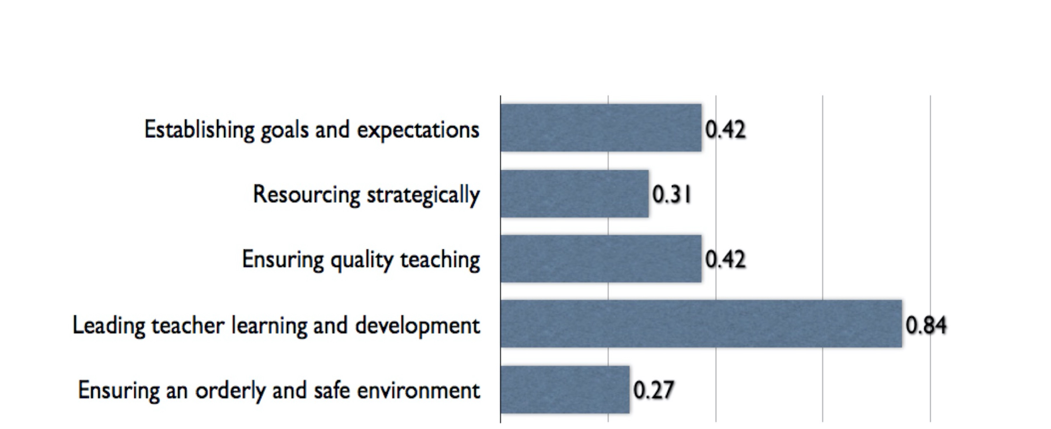
Effect Size: 5 Factors
Viviane Robinson

Slide 24

Conditions for Internal Accountability
Specificity (practices and outcomes)
Transparency (results are known inside and outside the organization)
Non-judgmentalism
Trust and interact

Slide 25

WHY SOME LEADERS SUCCEED AND OTHERS FAIL

Slide 26

Defining Nuance Leadership
  Action Informed by Deep Contextual Literacy

Slide 27
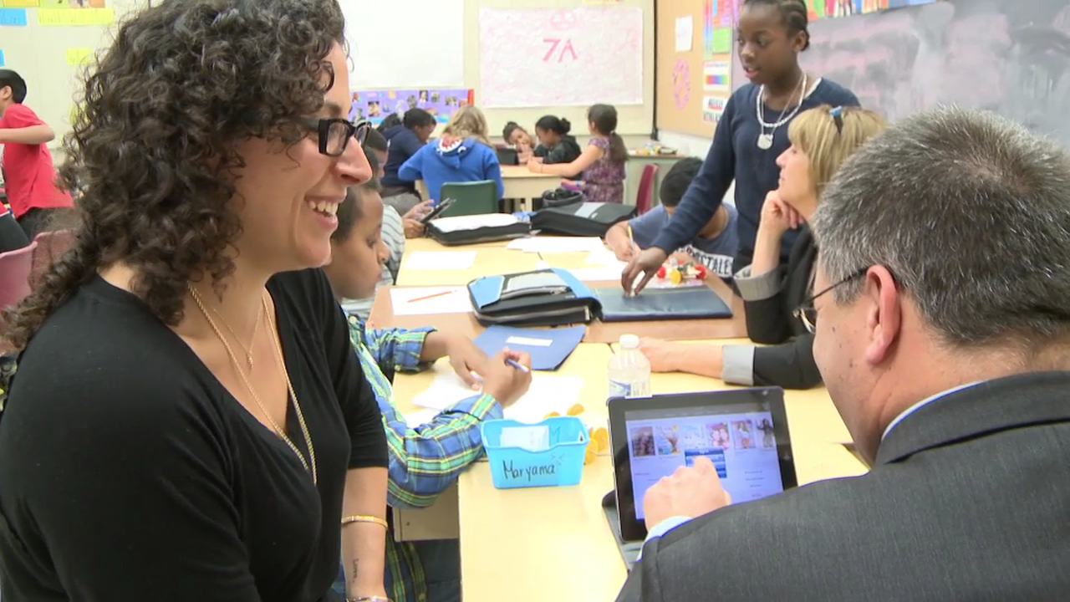
Key Leadership for Change Finding
Success occurs when leaders participate as learners with staff in changing the culture.

Slide 28






Cycles of trying things and making meaning
Leaders act on emerging solutions with focus and concern for impact
Co-learning dominates
New Leadership
Leaders help crystallize, articulate and feed back what they see
Leaders listen, learn, and ask questions
—Fullan, 2019

Slide 29

2021 Fast Forward
Phase Three:
Overload, Ambiguity, Innovation
(2020-present)
COVID Turns Everything Upside Down
Few Know What to do
Some see opportunity to innovate
Well-being and Learning Become a Priority

Slide 30
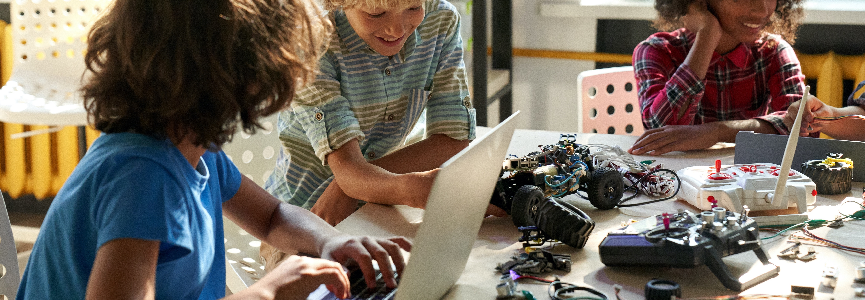
Need for Engaged Learning
A growing number of students
are bored with traditional schooling

Slide 31

Context
High School Seniors
only 24%
identify & pursue purpose in life
  —Stanford Center on Adolescence, Malin, 2018

Slide 32

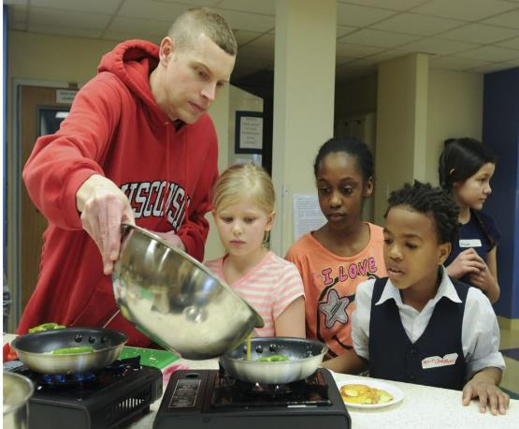
What is Mental Well-Being? (Dr.Jean)
A state of well-being in which an individual realizes his or her own potential, can cope with the normal stresses of life, can work productively and fruitfully, and is able to make a contribution to her or his community.
  World Health Organization, 2014
More than the absence of illness!
It is about FLOURISHING!
Notes:
What is well-being, and why does it matter so much for learning?
To me this really reperesents thinking about the whole child , their identity
and the connectivity to the world around them
Could we call this a goal of education?
It shifts the thinking, and I will be provocative here that education needs to shift to being about human development

Slide 33


Slide 34
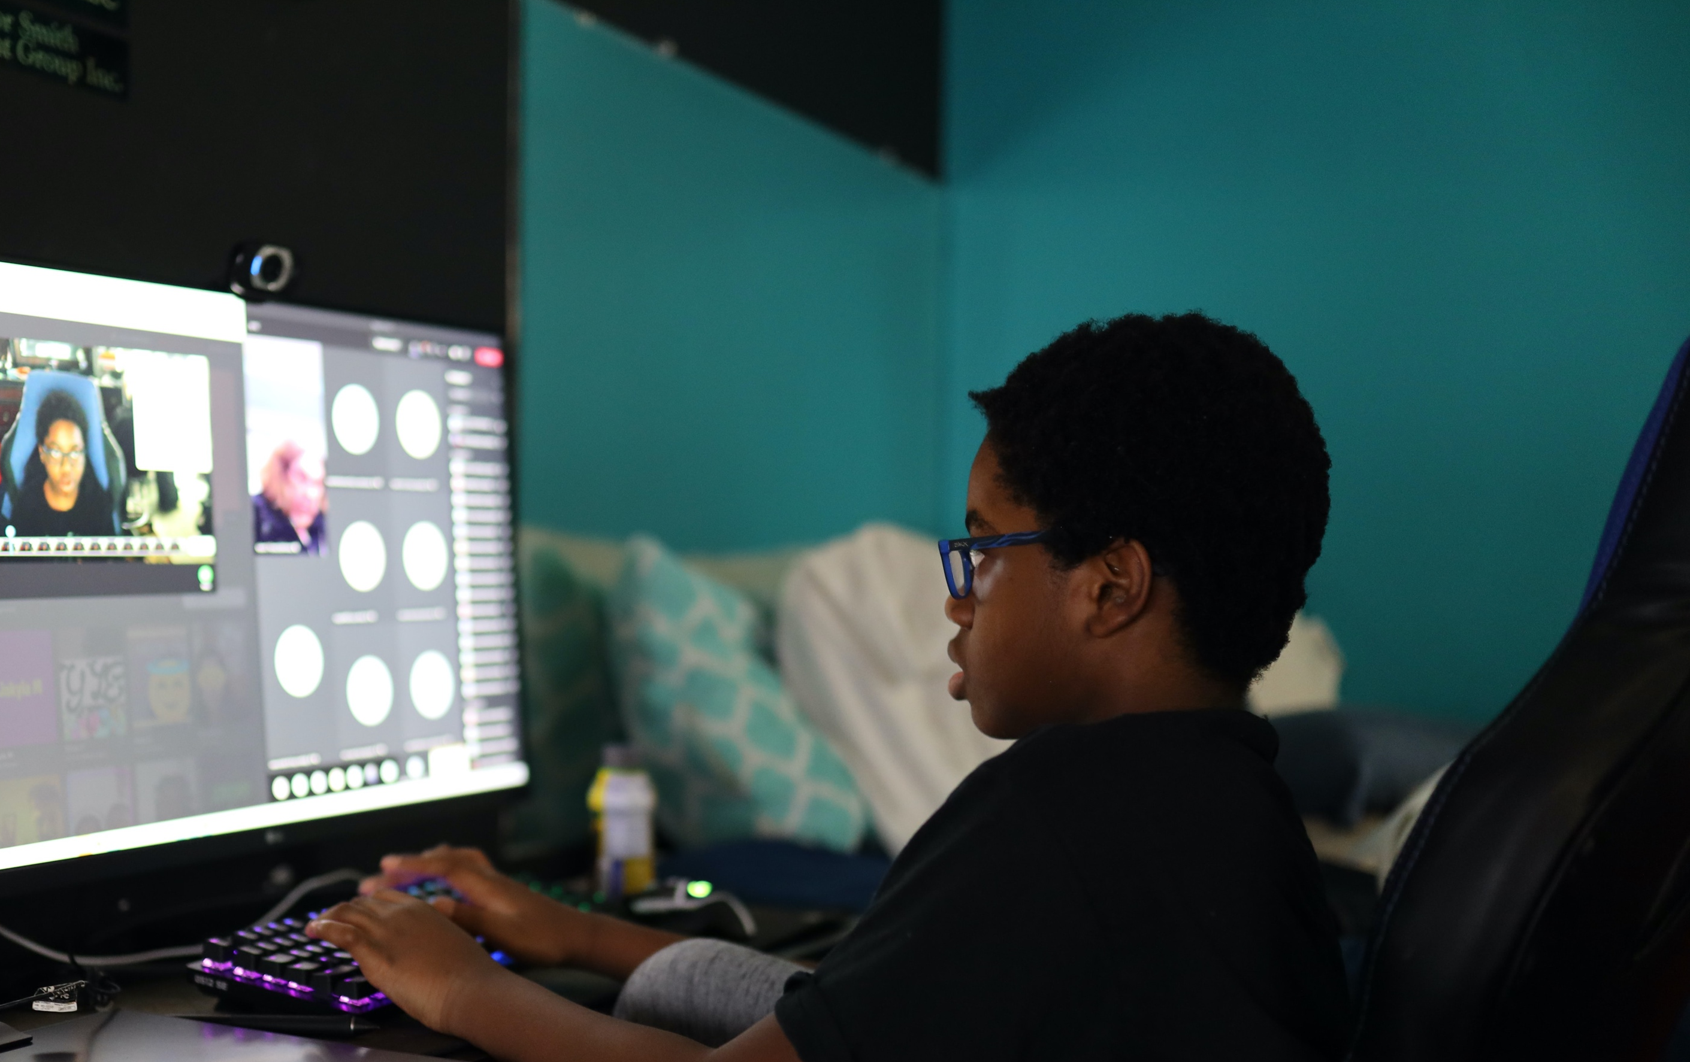
Basic access to devices, platforms, place to learn—a basic equity matter that applies to all.
After that it is all purpose, pedagogy, belongingness, culture.
Technology should never be the driver; only the accelerator.
Technology

Slide 35
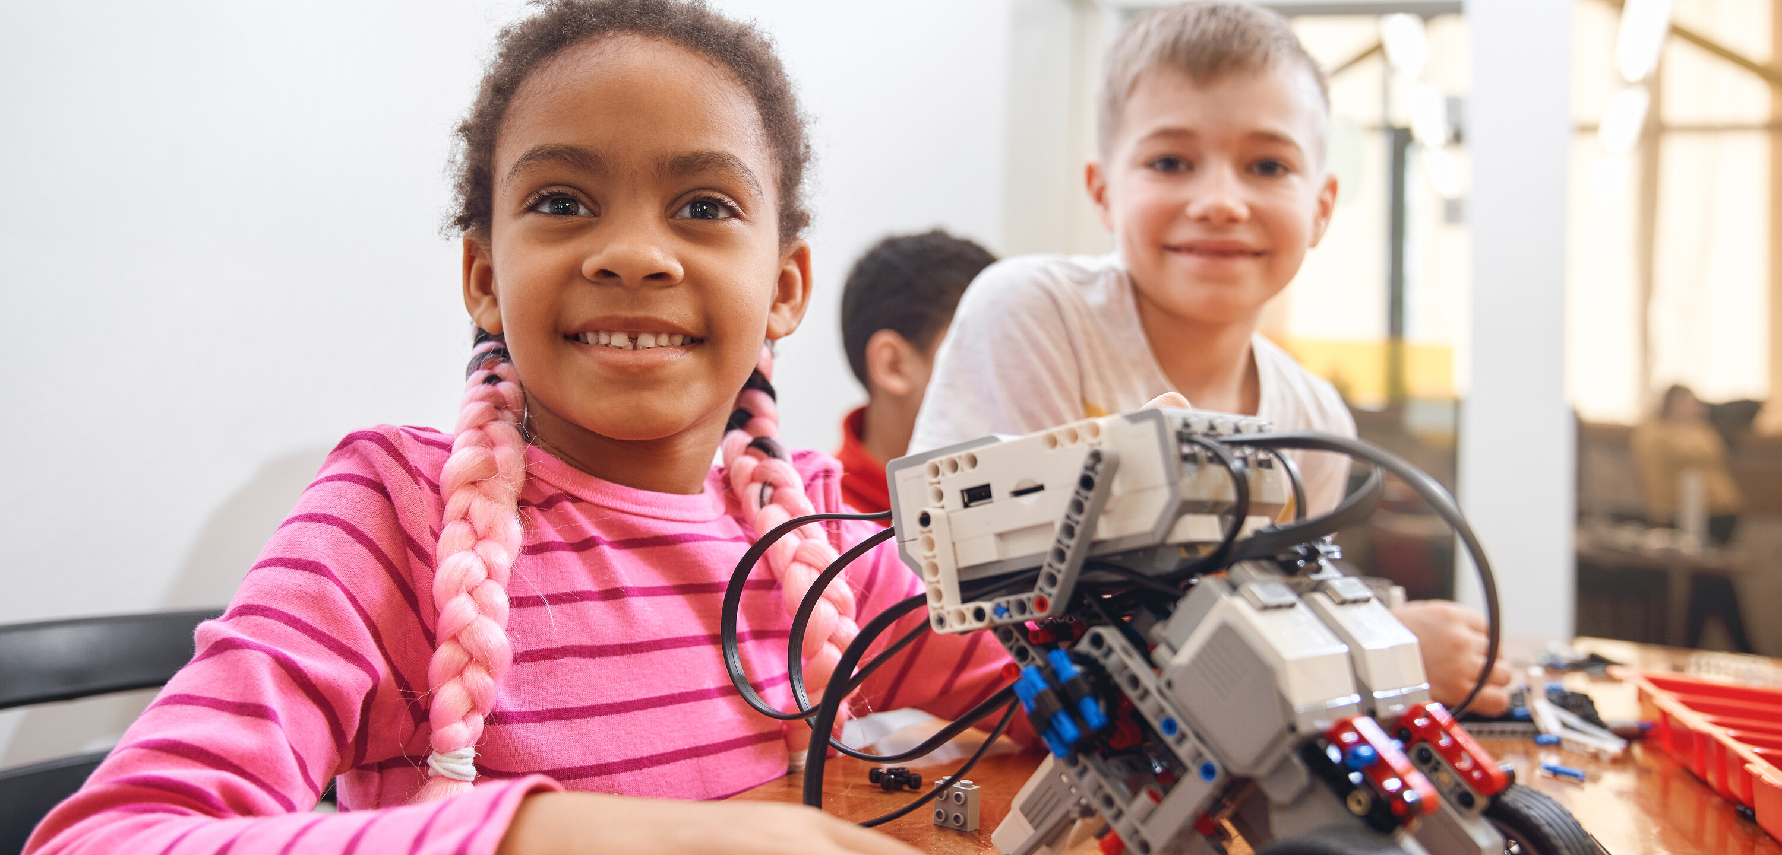
The Need for Change
Sort out the role of technology
Re-connect students to learning
Climate crisis
Well-being of students and adults
Develop new collaboration within and across schools.

Slide 36
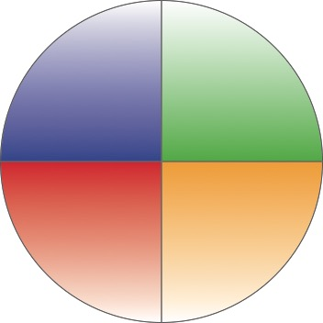
New Metrics
of Assessment: Formative,
Summative
New Purpose:
Meaning, Belonging, Contributing
What
is Needed
Four Essential Interactive Transformations
New
Cultures:
Always learning through connected autonomy
New Pedagogies:
Engaging, Discovering, Applying

Slide 37
The Future
Overload, ambiguity and potential innovation will happen faster than any other phase.
It has never been more crucial to be a learner!

