Slide 1
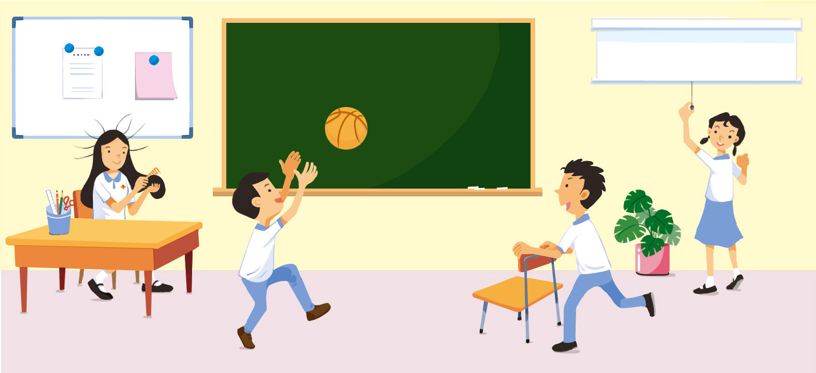
11.3 Balanced forces and free-body diagrams 平衡力和孤立物體圖
1.1
How many types of forces can you identify in the scene? 在這個場景中，你能辨識多少種力？

Slide 2
A Types of forces 力的種類
Forces 力
Contact force 接觸力 :
applies a force on another object through direct contact only 一個物體對另一個物體施力時兩者要互相接觸
Non-contact force 非接觸力 :
applies a force on another object at a distance, even when not in contact 一個物體對另一個物體 施力時兩者無須互相接觸， 甚至相隔一段距離

Slide 3
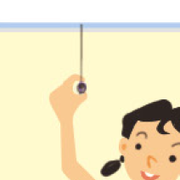
A Types of forces 力的種類
Contact forces 接觸力 :
projector screen 投影屏幕
pulling force 拉力

Slide 4
A Types of forces 力的種類
Contact forces 接觸力 :
moving direction 移動方向
friction 摩擦力

Slide 5
A Types of forces 力的種類
Contact forces 接觸力 :
supporting force 支撐力

Slide 6
A Types of forces 力的種類
Non-contact forces 非接觸力 :
electrostatic forces
靜電力
combed hairs repel each other and stand on end on a dry day 在乾燥的日子，梳理後的頭髮互相排斥並一根根豎起來

Slide 7
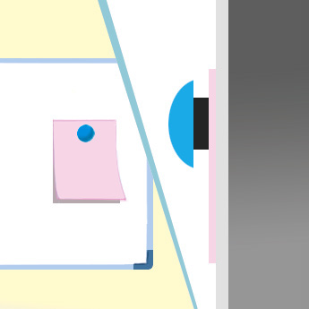
A Types of forces 力的種類
Non-contact forces 非接觸力 :
magnetic forces 磁力
magnet 磁鐵
white board 白板
paper 紙

Slide 8
A Types of forces 力的種類
Non-contact forces 非接觸力 :
force of gravity重力

Slide 9
11.4
Video
影片
Experiencing non-contact forces 感受非接觸力
Aim 目的
To experience non-contact forces 感受非接觸力

Slide 10
11.4
Part I Magnetic force
第一部分 磁力
1 Place a bar magnet on a bench. 把兩塊磁棒異極相向放在實驗桌上。
N
S
opposite poles facing each other 異極相向

Slide 11
11.4
1 Move another bar magnet slowly towards it with the opposite poles facing each other. 把一塊磁棒慢慢移近另一塊。
N
S
opposite poles facing each other 異極相向

Slide 12
11.4
1 Do the magnets attract each other before they are in contact? 兩塊磁棒靠近時，會不會吸引對方？
Yes. 會。
N
S
opposite poles facing each other 異極相向

Slide 13
11.4
2 Move a bar magnet towards another magnet on the bench with the same poles facing each other. 把兩塊磁棒改為同極相向，然後把一塊磁棒慢慢移近另一塊。
S
S
same poles facing each other 同極相向

Slide 14
11.4
2 Do the magnets repel each other before they are in contact? 兩塊磁棒靠近時，會不會排斥對方？
Yes. 會。
S
S
same poles facing each other 同極相向

Slide 15
11.4
Part II Electrostatic force
第二部分 靜電力
1 Blow up a balloon and tie off its end. Place some small bits of paper on a bench. 把氣球吹脹，然後綁住它的開口。把一些紙碎放在實驗桌上。

Slide 16
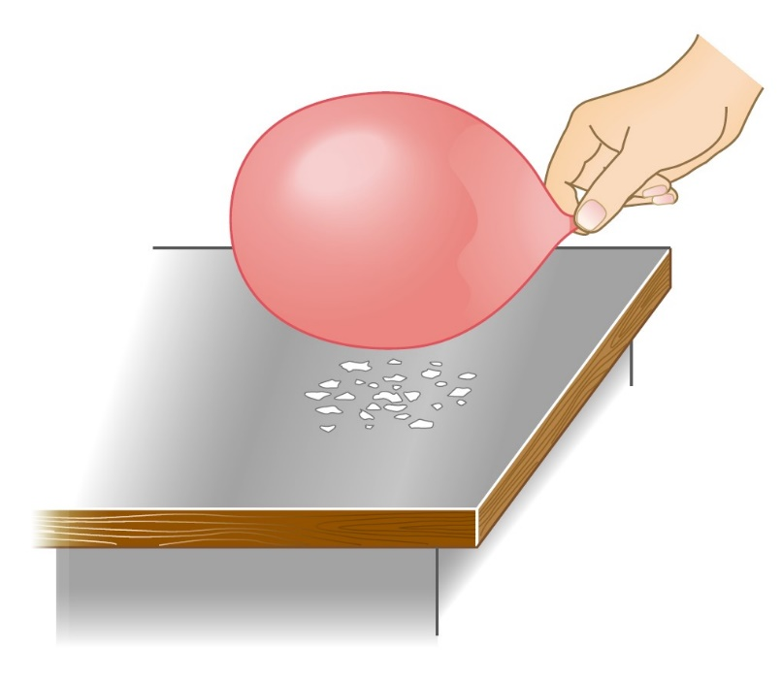
11.4
2 Rub the balloon on a piece of woollen cloth and immediately bring the balloon near the small bits of paper. 用羊毛布摩擦氣球，然後立即把氣球移近紙碎。

Slide 17
11.4
2 What do you observe? 你觀察到甚麼？
The balloon attracts the small bits of paper. 氣球吸引紙碎。

Slide 18
11.4
Discussion 討論
What are in common for the forces acting on the magnets in Part I and the forces acting on the small bits of paper in Part II? 在第一部分中施於磁棒的力和第二部分中施於紙碎的力有甚麼共通點？
They are both non-contact forces. 它們都是非接觸力。

Slide 19
A Types of forces 力的種類
Two magnets repel or attract each other at a distance. 兩塊磁棒在沒有互相接觸的情況下互相排斥或吸引。
repulsive or attractive forces acting on the magnets: 施於磁棒的排斥力或吸引力：
magnetic forces 磁力

Slide 20
A Types of forces 力的種類
The rubbed balloon attracts small bits of paper without touching them. 摩擦過的氣球在沒有接觸紙碎的情況下把紙碎吸引。
attractive force acting on the paper: 施於紙碎的吸引力：
electrostatic force 靜電力

Slide 21
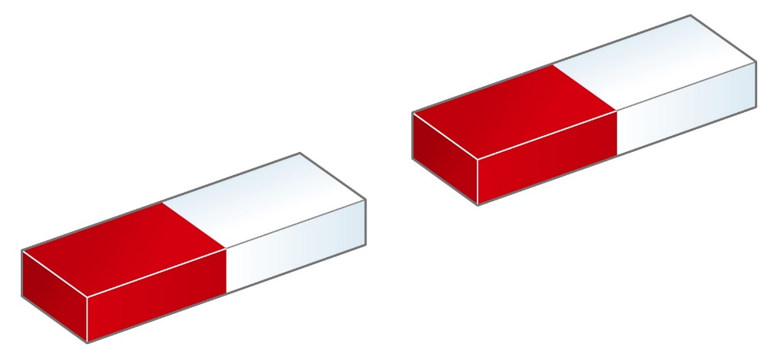
A Types of forces 力的種類
Both magnetic force and electrostatic force are non-contact forces. 磁力和靜電力都是非接觸力。

Slide 22
A Types of forces 力的種類
If an object applies a force on another object through direct contact only, this force is a _______________ force. 如果一個物體對另一個物體施力時兩者要互相接觸，所施加的力就是 ______________ 力。
If an object can apply a force on another object when they are not in direct contact, this force is a _______________ force. 如果一個物體對另一個物體施力時兩者無須互相接觸，所施加的力就是 ______________ 力。
contact
接觸
non-contact
非接觸

Slide 23
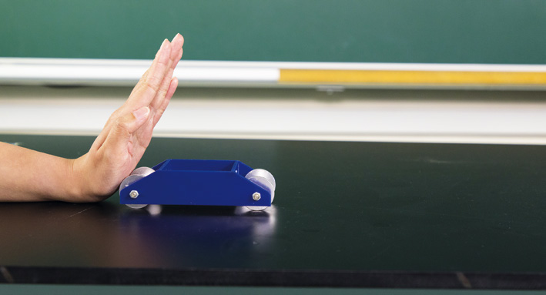
B Balanced forces and unbalanced forces 平衡力和不平衡力
When a trolley is pushed by a force, its motion changes. 小車受一道力作用時，它的運動狀態會改變。
an unbalanced force acts on the trolley 小車受到不平衡力作用

Slide 24
11.5
Video
影片
Balanced forces 平衡力
Aim 目的
To study the effect of two forces of equal size but acting in opposite directions 研究兩道大小相同但方向相反的力對物體的影響

Slide 25
11.5
1 Set the reading of the spring balance to zero if needed. 如果彈簧秤的讀數不是零，則把它調整為零。

Slide 26
11.5
2 Attach a spring balance to each end of a trolley as shown. 在小車的頭尾兩端各扣上一個彈簧秤。
trolley 小車
A
B

Slide 27
11.5
3 Hold balance A still and pull balance B with a force of 5 N. 握住彈簧秤 A，把它保持在固定的位置，並以 5 N 的力拉彈簧秤 B。
hold still
保持在固定的位置
pull with 5 N force 以 5 N 的力拉
trolley 小車
A
B

Slide 28
11.5
3 Record the readings of the balances. Assume that friction is negligible. 記錄兩個彈簧秤的讀數，假設摩擦力可忽略。
hold still
保持在固定的位置
pull with 5 N force 以 5 N 的力拉
trolley 小車
A
B

Slide 29
11.5
4 Repeat step 3 by pulling balance B with a force of 10 N. 改用 10 N 的力拉彈簧秤 B，重複步驟 3。
hold still
保持在固定的位置
pull with 10 N force 以 10 N 的力拉
trolley 小車
A
B

Slide 30
11.5
Results 結果
 | Reading of balance 彈簧秤讀數 (N)
 | A | B
In step 3 在步驟 3
In step 4 在步驟 4
5 N
5 N
10 N
10 N

Slide 31
11.5
Discussion 討論
1
a In steps 3 and 4, how are the readings of balances A and B related to each other? 在步驟 3 和 4 中，彈簧秤 A 和 B 的讀數有甚麼關連？
They are equal.
兩者是相等的。

Slide 32
11.5
1
b Does the trolley move when the forces acting on it by balances A and B are equal in size? 彈簧秤 A 和 B 把大小相同的力施於小車時，小車有沒有移動？
No.
沒有。

Slide 33
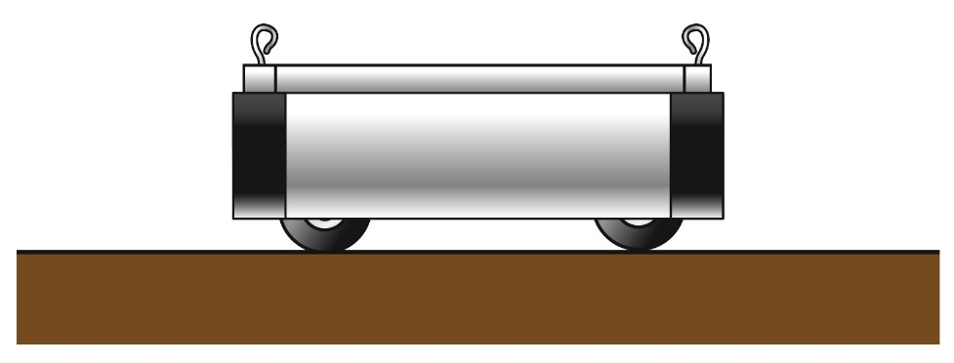
11.5
2 We can calculate the overall force that acts on the trolley. This force is called the net force. 我們可計算施於小車的力的總和，這道力稱為淨力。
force A 力 A
force B 力 B
The two forces act in opposite directions 這兩道力方向相反。
Net force acting on the trolley = force A – force B 施於小車的淨力 = 力 A – 力 B
trolley 小車

Slide 34
11.5
2 Calculate the net force acting on the trolley in steps 3 and 4. 計算在步驟 3 和 4 中，施於小車的淨力。
In step 3 在步驟 3 :
In step 4 在步驟 4 :
5 N – 5 N = 0 N
10 N – 10 N = 0 N

Slide 35
B Balanced forces and unbalanced forces 平衡力和不平衡力
The trolley does not move when two forces of the same size act on it in opposite directions. 小車受兩道大小相同但方向相反的力作用時， 並不會移動。
balanced forces 平衡力
does not move 不會移動
5 N
5 N

Slide 36
B Balanced forces and unbalanced forces 平衡力和不平衡力
All the forces acting on an object are balanced
(net force acting on the object is zero) 如果所有施於物體的力互相平衡
（施於物體的淨力是零）
Their effects are cancelled out 力對物體的影響會抵消
The speed and moving direction of the object do not change. 物體的速率和移動方向不會改變

Slide 37
B Balanced forces and unbalanced forces 平衡力和不平衡力
When all the forces acting on an object are balanced (net force is zero)... 如果所有施於物體的力互相平衡⋯⋯
（施於物體的淨力是零）
an object which is at rest originally 原本靜止的物體
an object which is already moving 正在移動的物體
remains at rest 保持靜止
moves at the original speed in the original direction 繼續以原來的速率移動， 而且移動方向不變

Slide 38
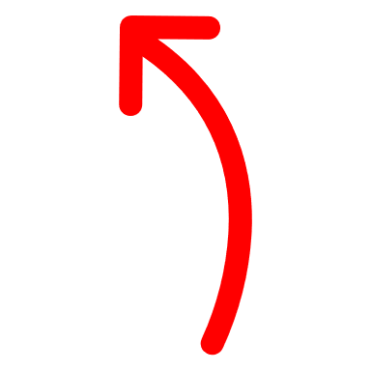
B Balanced forces and unbalanced forces 平衡力和不平衡力
If the forces acting on an object are unbalanced (net force is not zero)... 如果施於物體的力不平衡⋯⋯（施於物體的淨力不是零）
the speed and/or the direction of motion of the object will change 物體的速率和移動方向至少任何一項會改變。

Slide 39
B Balanced forces and unbalanced forces 平衡力和不平衡力
If all the forces acting on an object are balanced, the object will stay at rest or move in uniform motion. 如果所有施於物體的力互相平衡，物體就會保持靜止，或作勻速運動。
If the forces acting on an object are unbalanced, the object will move in non-uniform motion. 如果施於物體的力不平衡，物體就會作非勻速運動。

Slide 40
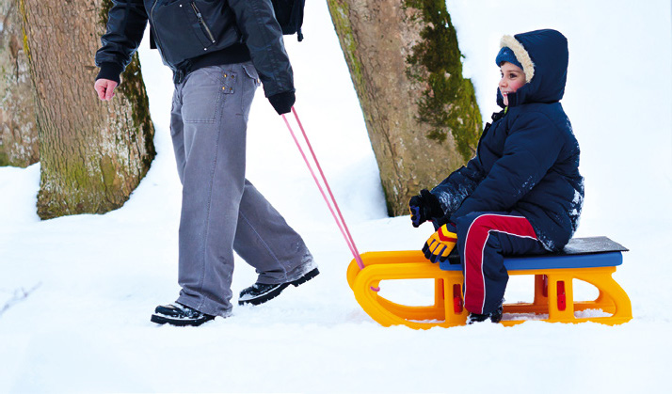
B Balanced forces and unbalanced forces 平衡力和不平衡力
Examples of balanced forces: 平衡力的例子：
a
The two forces cancel each other out; the sledge moves to the left at a constant speed 這兩道力互相抵消， 雪橇以恆速率向左移動
pulling force by the man 男子施加的拉力 (80 N)
friction 摩擦力 (80 N)

Slide 41
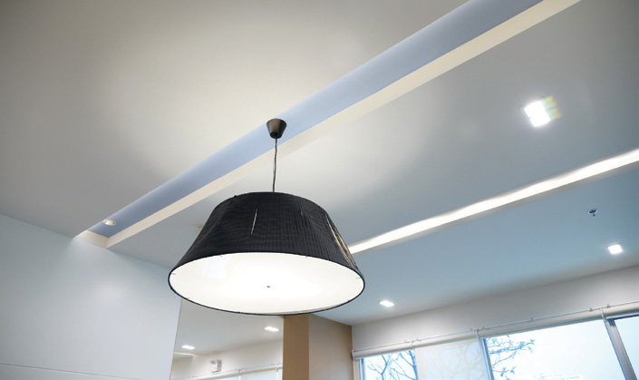
B Balanced forces and unbalanced forces 平衡力和不平衡力
Examples of balanced forces: 平衡力的例子：
b
lifting force by the ceiling 天花板施加向上的力 (25 N)
The two forces cancel each other out; the lamp stays at rest 這兩道力互相抵消，天花燈靜止不動
force of gravity 重力(25 N)

Slide 42
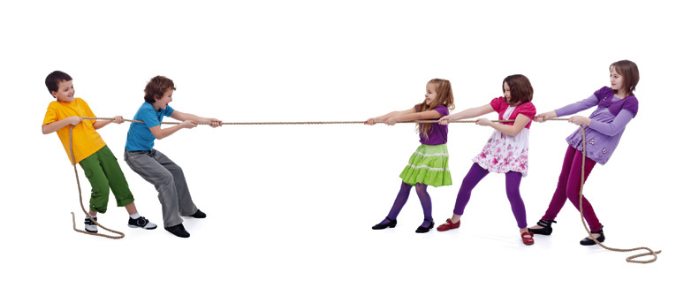
B Balanced forces and unbalanced forces 平衡力和不平衡力
Examples of unbalanced forces: 不平衡力的例子：
c
pulling force by the girls’ team 女子組施加的拉力 (200 N)
The girls’ pulling force is larger; the rope starts to move to the right 女子組施加的拉力較大， 繩子開始向右移動
pulling force by the boys’ team 男子組施加的拉力 (150 N)

Slide 43
B Balanced forces and unbalanced forces 平衡力和不平衡力
Examples of unbalanced forces: 不平衡力的例子：
d
lifting force by the hand 手施加向上的力 (0.15 N)
The lifting force is larger; the tea bag starts to move upwards 手施加向上的力較大， 茶包開始向上移動
force of gravity 重力 (0.05 N)

Slide 44
1 If two magnets stick together, the magnetic forces between them are contact forces. 如果兩塊磁鐵互相緊貼，它們之間的磁力便是接觸力。
✓
✗
✗

Slide 45
2 If two forces of the same size act on an object in the same direction, the two forces balance each other out. 如果施於某物體的兩道力大小相同且方向一致，這兩道力就會互相平衡。
✓
✗
✗

Slide 46
3 An object must be at rest when all the forces acting on it are balanced. 如果所有施於物體的力互相平衡，該物體必定會靜止不動。
✓
✗
✗

Slide 47
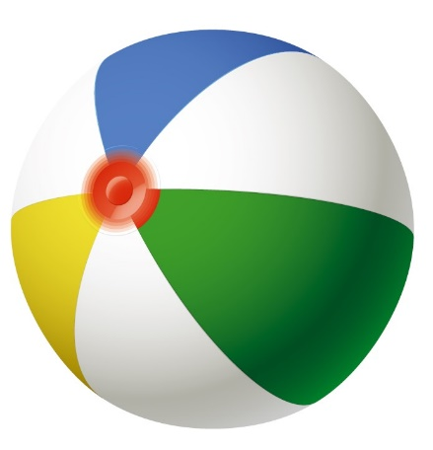
4 The diagram below shows the forces acting on a ball. 下圖顯示施於皮球的所有力。
4 N
10 N
6 N
Find the net force acting on it. 找出施於皮球的淨力。
10 N – 4 N – 6 N = 0 N

Slide 48
C Free-body diagrams 孤立物體圖
Free-body diagram 孤立物體圖（又稱隔離體圖）:
find out whether the forces acting on the object are balanced or not 判斷施於同一物體的力是否互相平衡
includes all the forces acting on the object only 顯示所有施於該物體的力

Slide 49
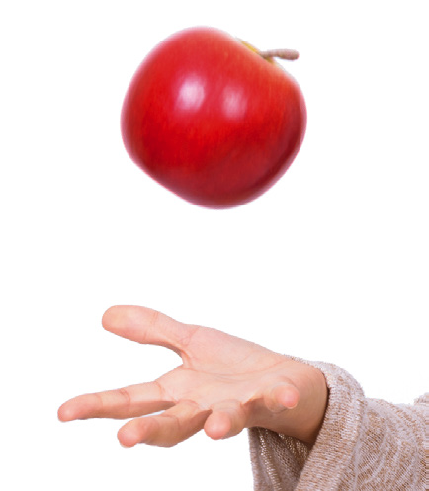
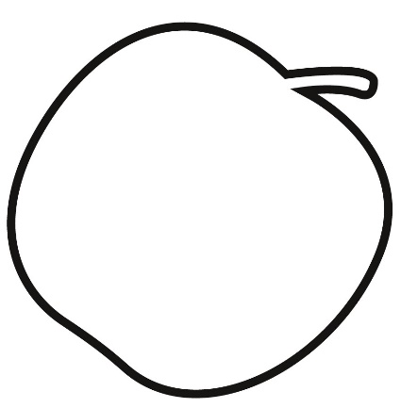
C Free-body diagrams 孤立物體圖
Free-body diagrams of an apple 蘋果的孤立物體圖 :
apple in mid-air 拋到半空中的蘋果
a
force of gravity 重力

Slide 50
C Free-body diagrams 孤立物體圖
Free-body diagrams of an apple 蘋果的孤立物體圖 :
apple in mid-air 拋到半空中的蘋果
a
Force is unbalanced 施於蘋果的力不平衡
Apple will be in non-uniform motion 蘋果會作非勻速運動
force of gravity 重力

Slide 51
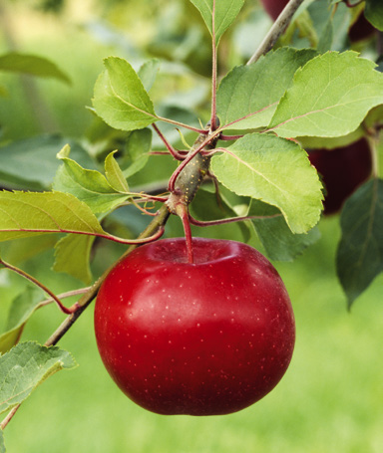
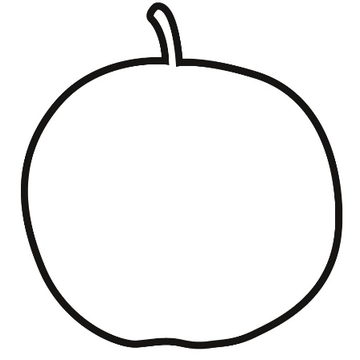
C Free-body diagrams 孤立物體圖
apple hanging on tree 樹上的蘋果
lifting force by the stem 蘋果樹枝施加向上的力
b
force of gravity 重力

Slide 52
C Free-body diagrams 孤立物體圖
apple hanging on tree 樹上的蘋果
lifting force by the stem 蘋果樹枝施加向上的力
b
Forces are balanced (opposite in direction and equal in size) 施於蘋果的兩道力互相平衡（方向相反，但大小相等）
Apple remains at rest 蘋果保持靜止狀態
force of gravity 重力

Slide 53
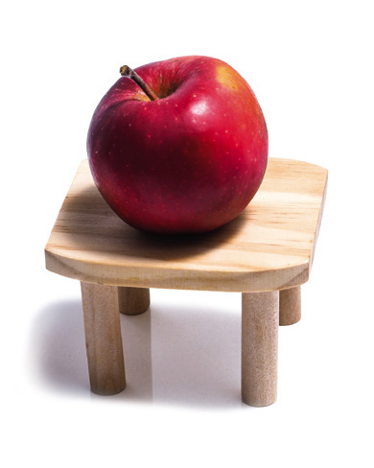
C Free-body diagrams 孤立物體圖
apple sitting on table 桌子上的蘋果
c
supporting force by the table 桌子施加的支撐力
force of gravity 重力

Slide 54
C Free-body diagrams 孤立物體圖
apple sitting on table 桌子上的蘋果
c
supporting force by the table 桌子施加的支撐力
Forces are balanced (opposite in direction and equal in size) 施於蘋果的兩道力互相平衡（方向相反，但大小相等）
Apple remains at rest 蘋果保持靜止狀態
force of gravity 重力

Slide 55
11.2
Video
影片
Drawing free-body diagrams 繪畫孤立物體圖
Note the skills in drawing a free-body diagram of an object. A hedgehog rolls into a ball on a chair. It is taken as the object. 細閱以下繪畫物體的孤立物體圖的步驟。一隻刺蝟在椅子上捲作一團，我們把這隻刺蝟視作一個物體，並繪畫牠的孤立物體圖。

Slide 56
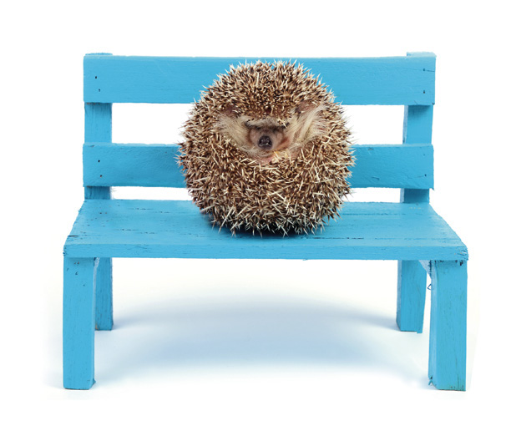
11.2
Steps 步驟
Identify the target object in the photo. Isolate it from its surroundings. 辨識圖中的目標物體，把它與周圍環境隔離。
1

Slide 57
11.2
Steps 步驟
Draw a single object, i.e. the target object, only. No need to sketch its details. Just draw the rough outline of its shape. 只繪畫單一物體，即目標物體。 勾畫它大概的輪廓便可，無須繪畫它的細節。
2

Slide 58
11.2
Steps 步驟
Find out all the forces acting on the object. Note their sizes and directions, and their points of action on the object. 找出所有施於該物體的力，並留意這些力的大小和方向，以及施力的位置。
3
supporting force by the chair 椅子施加的支撐力
force of gravity 重力

Slide 59
11.2
Steps 步驟
Draw arrows to represent the forces and label each of them. Note that the arrows must come in contact with the object. 繪畫箭號以代表每道力，並標示箭號。留意每個箭號必須與物體接觸。
supporting force by the chair 椅子施加的支撐力
4
force of gravity 重力

Slide 60
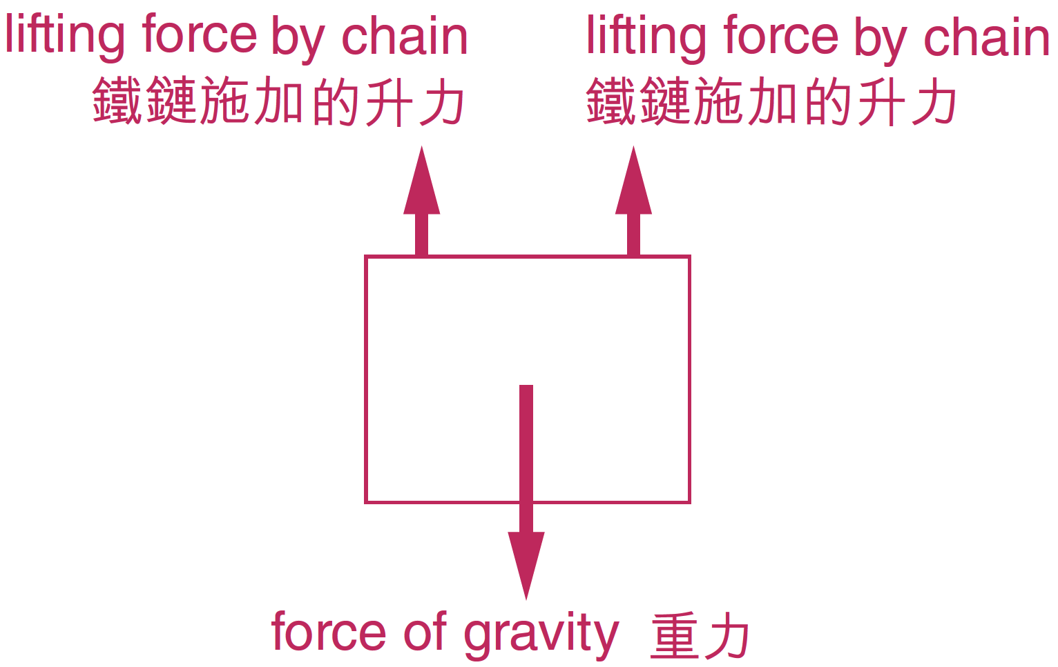
11.2
A small blackboard is hanging on the wall with chains as shown. Draw a free-body diagram of the blackboard in the space given. 如圖所示，小黑板以兩條鐵鏈懸掛在牆上。在下面的空位繪畫黑板的孤立物體圖。

Slide 61
11.3
The key points about force covered in this section are summarized below: 本節中關於力的重點總結如下：
Force 力 | Forces can be classified as contact forces or non-contact forces. 力可分為接觸力或非接觸力。

Slide 62
11.3
Contact force 接觸力 | It acts on an object through direct contact only. 一個物體對另一個物體施力時兩者要互相接觸。
Non-contact force 非接觸力 | It can act on an object without direct contact. 一個物體對另一個物體施力時兩者無須互相接觸。

Slide 63
11.3
Balanced forces 平衡力 | When all forces acting on an object cancel each other out, the forces are balanced. The object is at rest or in uniform motion, i.e. it is moving at a constant speed in one direction. 如果所有施於物體的力互相抵消，即這些力互相平衡，物體便會保持靜止或作勻速運動，即以恆速率移動且移動方向不變。

Slide 64
11.3
Unbalanced forces 不平衡力 | When all forces acting on an object cannot cancel each other out, the forces are unbalanced. The object is in non-uniform motion, i.e. its speed and/or direction of motion changes. 如果所有施於物體的力不能互相抵消，即這些力不平衡，物體便會作非勻速運動，即速率和移動方向至少任何一項會改變。

Slide 65
11.3
Free-body diagram 孤立物體圖 | It is a diagram showing all the forces acting on an object. It can help determine if the forces are balanced or not. 它顯示所有施於同一物體的力，可用來判斷這些力是否 互相平衡。

Slide 66
11.3
Level 1
程度 1
1 An object is moving faster and faster. Are the forces acting on it balanced or unbalanced? (1 mark) 某物體移動得愈來愈快。所有施於它的力是平衡力還是不平衡力？ （1分）
Unbalanced. (1)
不平衡力。(1)
← p. 194

Slide 67
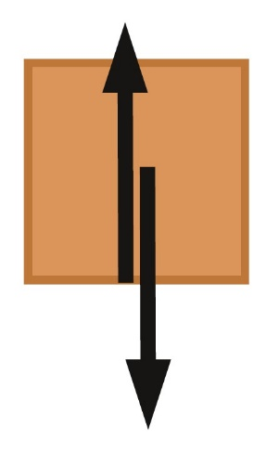
11.3
Level 1
程度 1
2 Determine whether the forces acting on the box are balanced or unbalanced in each case. (3 marks) 在下列每種情況下，施於箱子的兩道力是平衡力還是不平衡力？ （3分）
a
10 N
Balanced. (1)
平衡力。 (1)
10 N
← p. 195

Slide 68
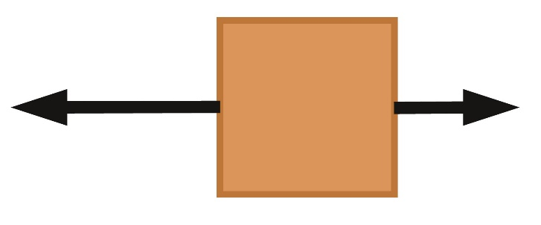
11.3
Level 1
程度 1
2 Determine whether the forces acting on the box are balanced or unbalanced in each case. (3 marks) 在下列每種情況下，施於箱子的兩道力是平衡力還是不平衡力？ （3分）
b
10 N
6 N
Unbalanced. (1)
不平衡力。 (1)
← p. 195

Slide 69
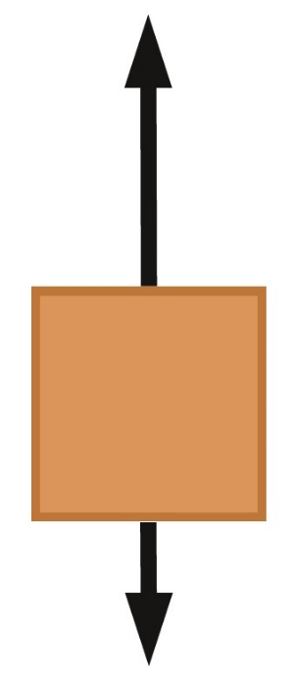
11.3
Level 1
程度 1
2 Determine whether the forces acting on the box are balanced or unbalanced in each case. (3 marks) 在下列每種情況下，施於箱子的兩道力是平衡力還是不平衡力？ （3分）
10 N
c
Unbalanced. (1)
不平衡力。 (1)
5 N
← p. 195

Slide 70
11.3
Level 2
程度 2
3 Refer to the photo below. A bell sits still on a horizontal table. 參看下圖，一個按鈴在水平桌子上靜止不動。
supporting force 支撐力
pressing force 按鍵的力
force of gravity 重力
← p. 189–195

Slide 71
11.3
Level 2
程度 2
3
a Write ‘✓’ for a true statement and ‘✗’ for a false statement. (3 marks) 細閱以下句子，正確的加上「✓」，不正確的加上「✗」。 （3分）
i The supporting force is a contact force. 支撐力是一種接觸力。
✓
✓
✗
← p. 189–195

Slide 72
11.3
Level 2
程度 2
3
a Write ‘✓’ for a true statement and ‘✗’ for a false statement. (3 marks) 細閱以下句子，正確的加上「✓」，不正確的加上「✗」。 （3分）
ii The forces acting on the bell are balanced. 所有施於按鈴的力互相平衡。
✓
✓
✗
← p. 189–195

Slide 73
11.3
Level 2
程度 2
3
a Write ‘✓’ for a true statement and ‘✗’ for a false statement. (3 marks) 細閱以下句子，正確的加上「✓」，不正確的加上「✗」。 （3分）
iii The pressing force must be smaller in size than the supporting force. 按鍵的力必定比支撐力小。
✓
✓
✗
← p. 189–195

Slide 74
11.3
Level 2
程度 2
3
b The supporting force is 5.6 N and the force of gravity is 4 N. 假設支撐力是 5.6 N，而重力是 4 N。
i Find the size of the pressing force. (1 mark) 找出按鍵的力的大小。 （1分）
Pressing force = 5.6 – 4 = 1.6 N (1)
按鍵的力 = 5.6 – 4 = 1.6 N (1)
← p. 189–195

Slide 75
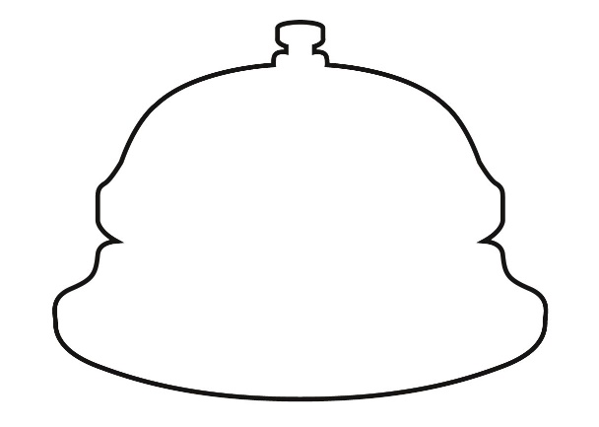
11.3
Level 2
程度 2
3
b The supporting force is 5.6 N and the force of gravity is 4 N. 假設支撐力是 5.6 N，而重力是 4 N。
ii Complete the free-body diagram of the bell below. (3 mark) 在下面的空位完成按鈴的孤立物體圖。 （3分）
pressing force 按鍵的力
Correct arrows (1 × 3) 箭號正確
(1 × 3)
supporting force 支撐力
force of gravity 重力
← p. 189–195

Slide 76
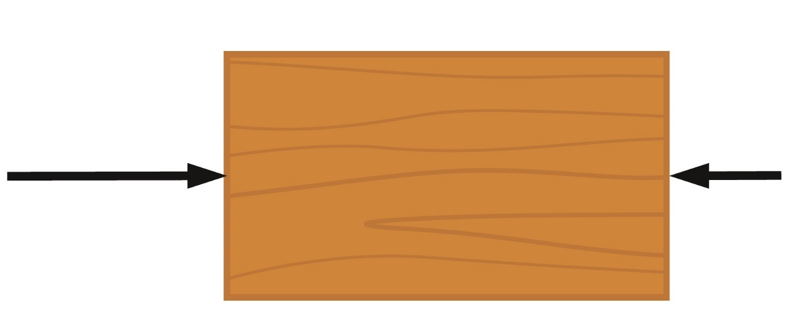
11.3
Level 2
程度 2
4 Draw a force in the diagram below so that the wooden block can stay at rest. (2 marks) 在下圖繪畫一道力，使木塊保持靜止狀態。 （2分）
15 N
8 N
7 N
Correct direction (1)
Correct size (1)
方向正確 (1)
大小正確 (1)
← p. 195

